Slide 1
Potential of ML
Based on recent interviews and publications from: Google AI Chief and former head of Google Brain Jeff Dean
Gene Olafsen

Slide 2
Overview
Google AI Chief and former head of Google Brain Jeff Dean co-published the paper A New Golden Age in Computer Architecture: Empowering the Machine-Learning Revolution.
https://ieeexplore.ieee.org/document/8259424/

Slide 3
Model-Design guidelines
Engineers are advised to look forward at least five years for hardware development.
An appropriate design must remain relevant through at least a two-year design and three-year deployment window to maintain a competitive edge*.
* assuming standard depreciation projections.

Slide 4
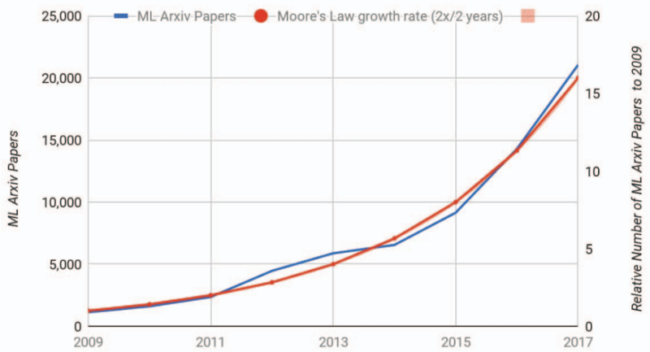
ML growth trend has already surpassed Moore’s Law (1975)

Slide 5
Model Scaling
According to Mathew Lodge, senior vice president of products and marketing at data science platform provider Anaconda. "AI models need to scale by factors of at least 10X each year."

Slide 6
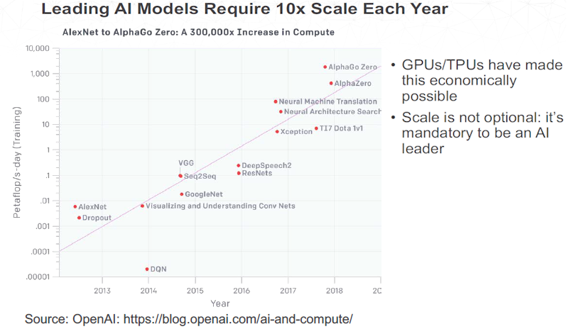
10x Scale

Slide 7
Following on the heels...
Big Data
Machine Learning
Machine learning is following on the heels of ‘Big Data’, which typically means an enterprise has employed MapReduce with additional data manipulation done with Java.
Machine learning engineers are working with R and Python.

Slide 8
Go parallel... or go home
Dask
Provides advanced parallelism for analytics, enabling performance at scale
Uses existing Python APIs and data structures to make it easy to switch between Numpy, Pandas, Scikit-learn to their Dask-powered equivalents
Tensorflow
Parallelization is built right in

Slide 9
Package, and ship
Once deployed and in product, the tasks of running and managing the model – such using containers and Kubernetes, scheduling, security, and upgrades – are automated.

Slide 10
Issues impacting ML Hardware design in the next five years
Training
Batch Size
Sparsity and Embeddings
Quantization and Distillation
Networks with Soft Memory
Learning to Learn (L2L)

Slide 11
Training vs inferencing
Development Phase:
Training
Learning
Production Phase:
Inference
Prediction

Slide 12
Training overhead
Requires 3X the arithmetic operations of inferencing
Activation values calculated through feedforward must be saved for back-propagation and thus add to memory pressure
Training cannot scale up like inference (many sequential steps)

Slide 13
Batch size
Batch size enables an important form of operand reuse.
The setting of minibatch size can greatly affect the efficiency of gradient descent in ML training.
However, the setting of minibatch size is still poorly understood.

Slide 14
Empirical batch
Empirical results are confusing:
A recent sequence of articles has shown that image-oriented convolutional models can train effectively at minibatch sizes of 8,192 and 32,768.
Note: multi-layer perceptron classifiers or for LSTM-based models are not as efficiently training on such large minibatch sizes.

Slide 15
Large 'minibatch'
Such effective large batch size training is not compatible with parallel scaling strategies.

Slide 16
Gradient Descent Options (review)
Variants:
Gradient Descent
Stochastic Gradient Descent
Batch Gradient Descent
Minibatch Gradient Descent

Slide 17
Gradient descent
Computing the cost and gradient for the entire training set can be very slow
Intractable on a single machine if the dataset is too big to fit in memory
Doesn’t provide an easy way to incorporate new data in an ‘online’ set.

Slide 18
SGD – Stochastic Gradient Descent
On large datasets, SGD can converge faster because it updates weights after each training sample.
Stochastic gradient descent does not readily lend itself to parallelization as the you need the feedback from one iteration to proceed with the next iteration.
The path towards the global cost minimum is not "direct" as in GD, but may go "zig-zag" if we are visualizing the cost surface in a 2D space.

Slide 19
Batch Gradient Descent
Batch gradient descent is a variation of the gradient descent algorithm that calculates the error for each example in the training dataset, but only updates the model after all training examples have been evaluated.
NOTE: Running through one cycle of the training dataset is called an epoch.

Slide 20
Mini-Batch Gradient Descent
Mini-batch gradient descent splits the training dataset into small batches that are used to calculate the model error and update the model coefficients. Since the model update frequency is higher than BGD it often provides more robust convergence, avoiding local minima.
Error information must be accumulated across mini-batches
The introduction of additional hyperparameters.
Yann LeCun (Facebook Chief AI Scientist) does not favor large minibatch size. He recently tweeted, “Training with large minibatches is bad for your health. More importantly, it’s bad for your test error. Friends don’t let friends use minibatches larger than 32.”

Slide 21
Sparsity and embeddings (sparcity first)
Many AI researchers want to develop increasingly larger models, but want individual examples to activate a tiny part of the large model- thus large models, sparsely activated.

Slide 22
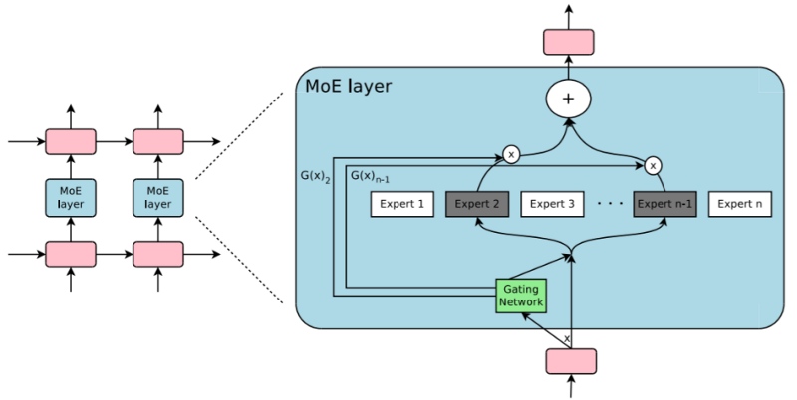
Mixture of experts
Google Brain employs a so-called 'Mixture of Experts' (MoE) model, which achieves a desired level of sparsity by consulting the learned subset of a panel of "experts". As a result, MoE models train more weights using fewer flops for higher accuracy than previous approaches.

Slide 23
embedding
Embeddings are used to transform large sparse data into more compact, dense representations and are commonly used in web search and translation applications.

Slide 24
Quantization and Distillation
Quantization (reduced-precision computation) has already proved useful helping models run faster and use less power.
Work is being done by NVidia and Baidu which involves mixed precision architectures.
Distillation uses a larger model to bootstrap the training of a smaller model while achieving higher accuracy, instead of directly training the smaller model on the same inputs. (Hinton 2014)

Slide 25
Soft memory networks
Some deep-learning techniques provide functionality akin to random-access memory; doing so is complicated by preserving differentiability so the techniques can support back-propagation. Examples include Neural Turing Machines, memory networks, and attention. Attention allows Google Translate to map from a word in the target language to the corresponding word or phrase in the source language. Such soft mechanisms are expensive compared to traditional “hard” memories, because the soft memory computes a weighted average over all entries of a table. A hard memory simply loads a single entry from a table. We haven’t seen research into efficient or sparse implementations of these soft memory models.

Slide 26
L2l – learning to learn
Envisioned to address the shortage of ML experts.
Recommendation: let's not encourage such research
Some success, the CIFAR-10 image recognition competition showed that L2L could match the accuracy of the best models developed by ML experts.

Slide 27
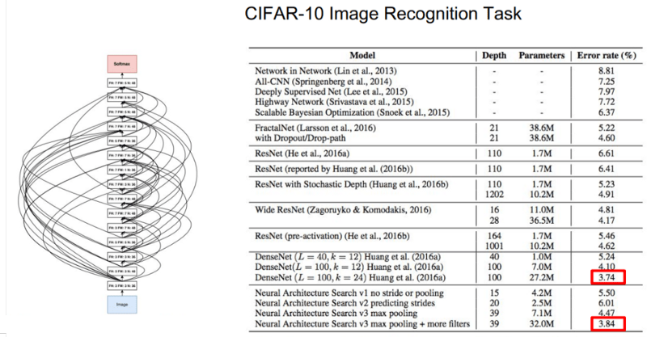
CIFAR

Slide 28
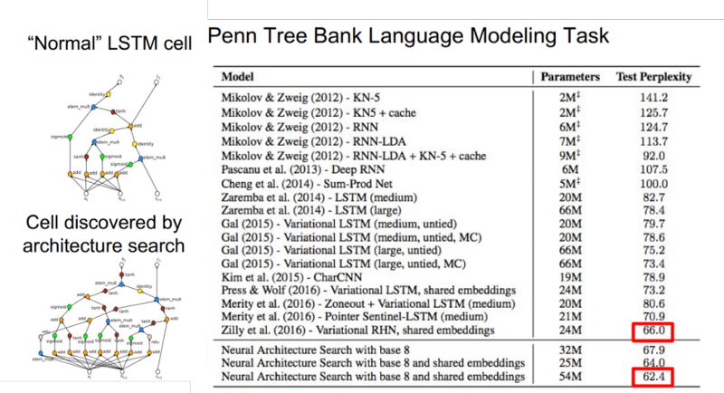
language

